Slide 1
Task1 crop below picture: Below screenshot shows the execution of above command:
![](pic/1-9-3-ls.png)
Page 11 – add ansible --version info
Task 2 > step 6 nxos_config instead of ios_config
Task2 > step 7 pic updated … 3-7-1.png (add snapshot for ansible install)
Task2 > step 3-12-1.png (replace)
Task 4> update 4-3-1.png … 4-3-2.png (replace and ignore Warning)
Task 4 > Step 8 > change tex headings
Task 4 > 4-4-1 and 4-4-2 .. Add ignore warning on
Task4 > 4-6-1.png … ignore warning
Task 5 > change diagram

Slide 2
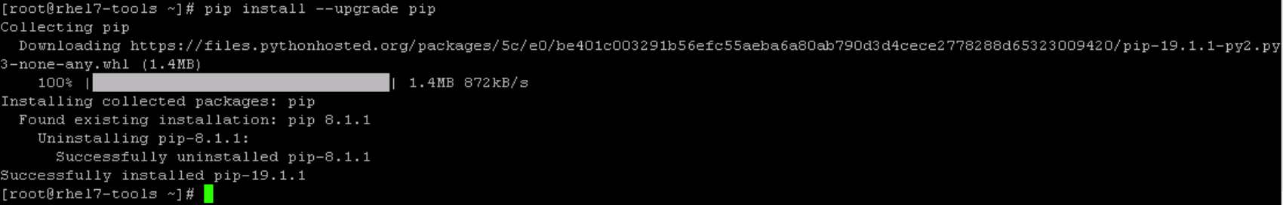

Slide 3
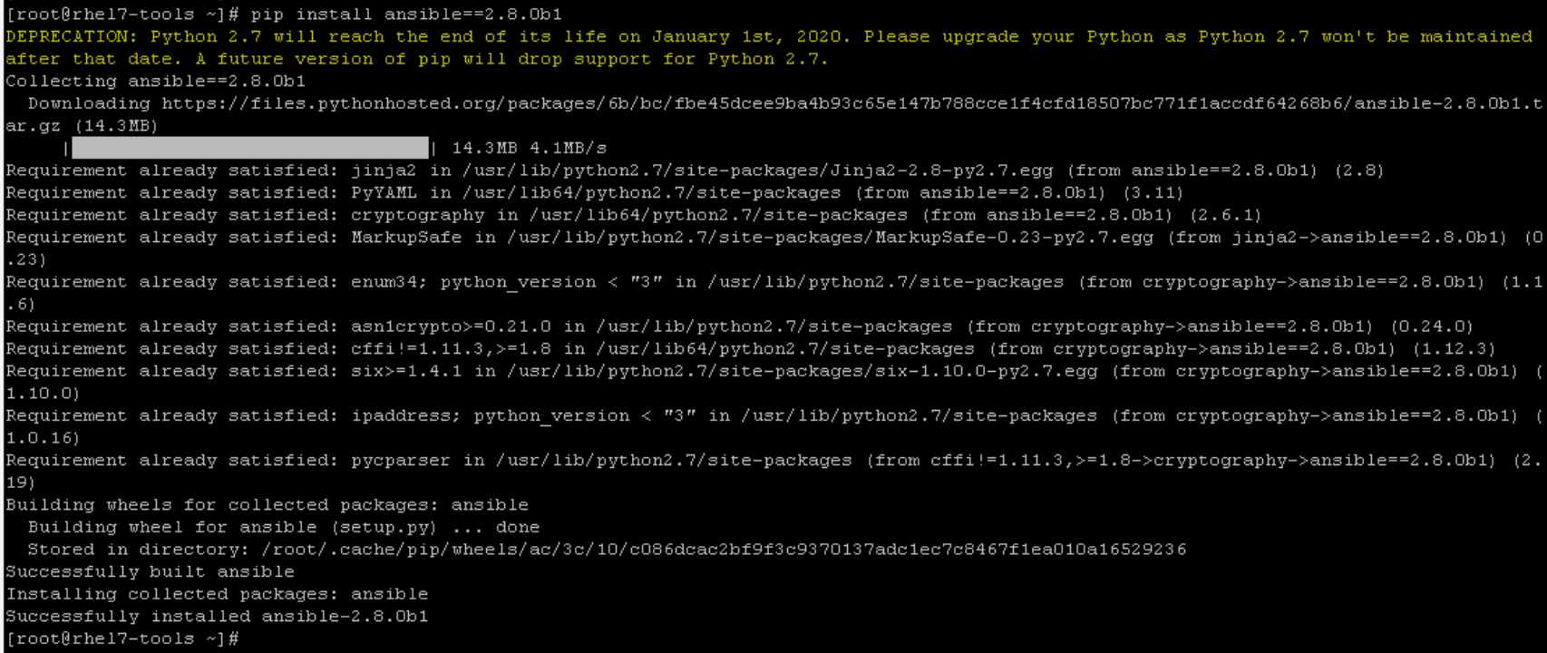

Slide 4
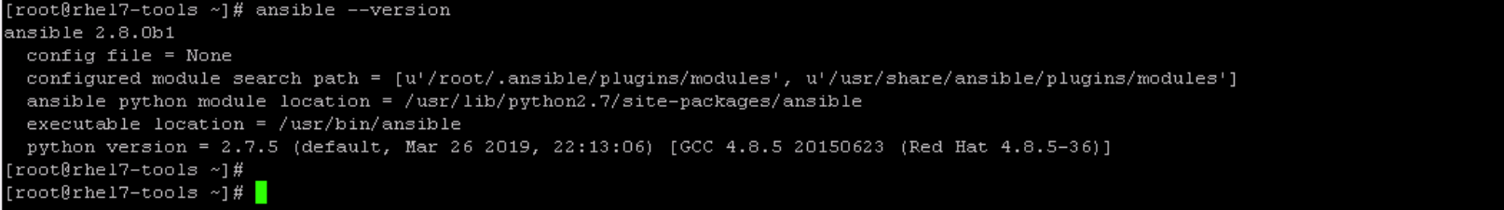

Slide 5
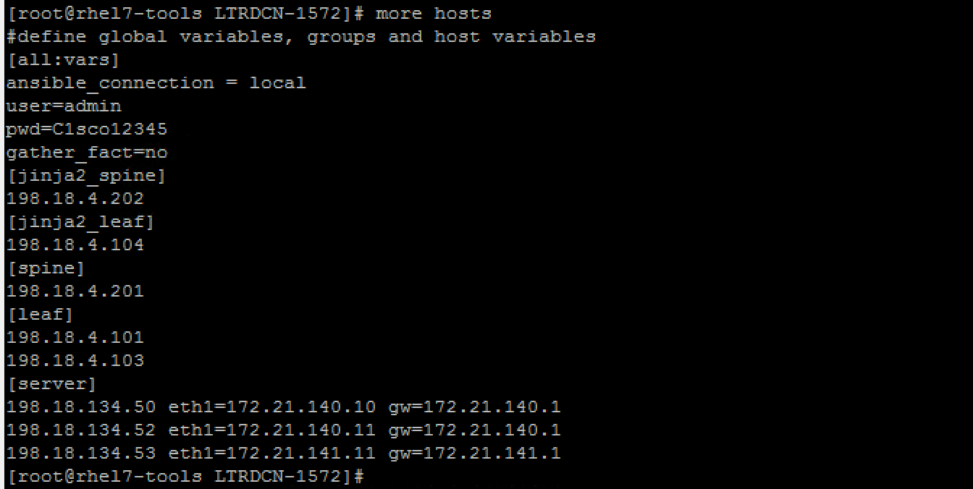

Slide 6
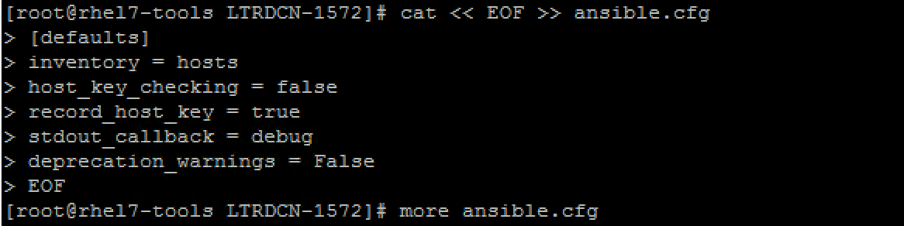
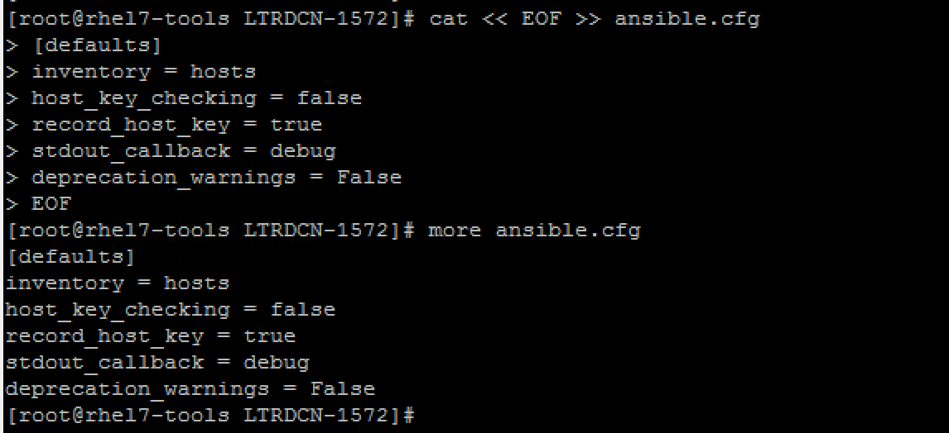

Slide 7
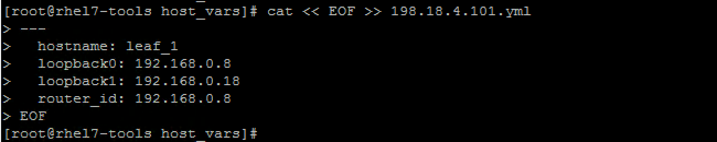
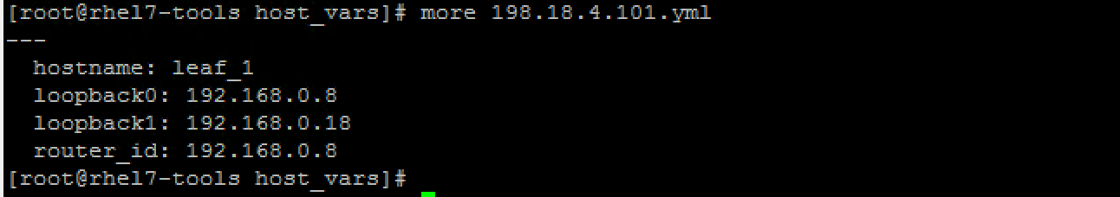

Slide 8
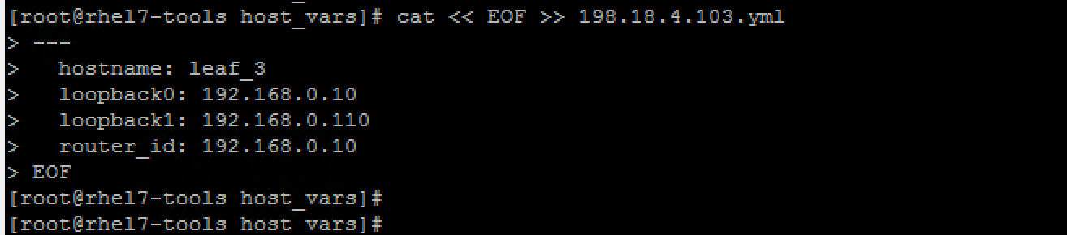
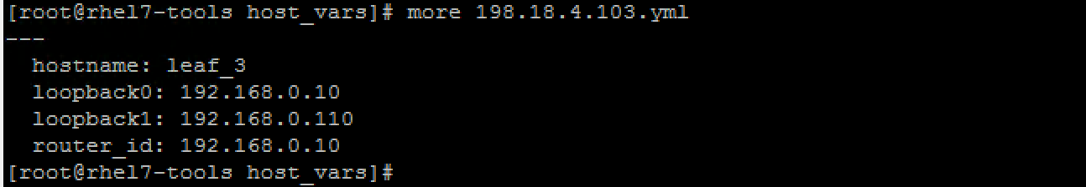

Slide 9
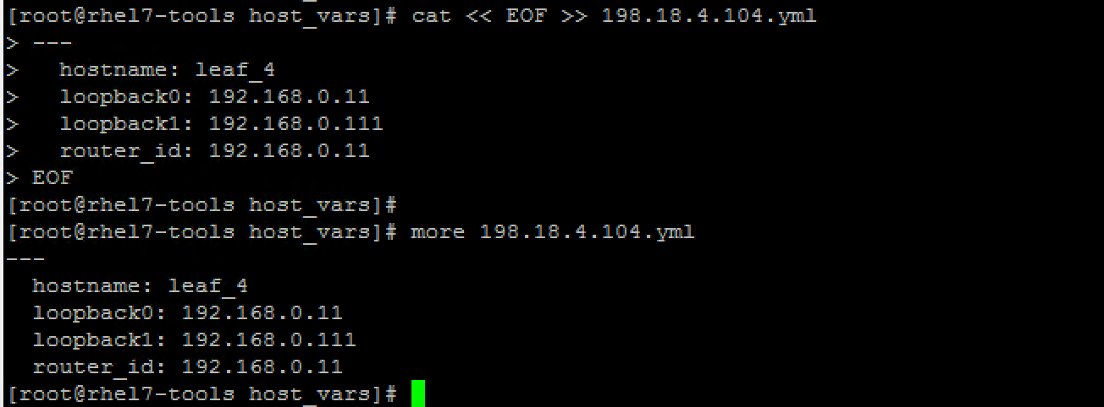

Slide 10
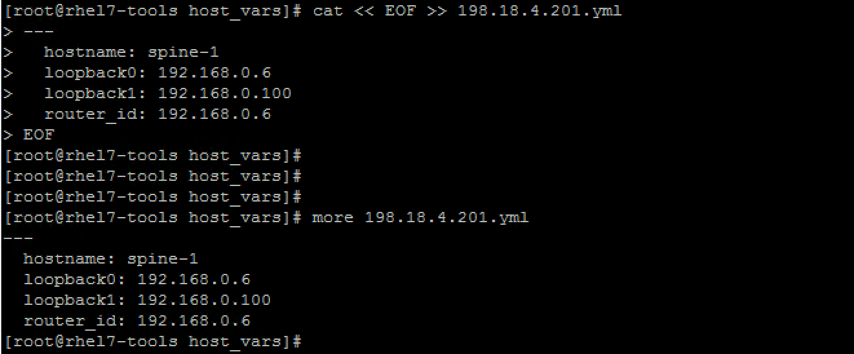

Slide 11
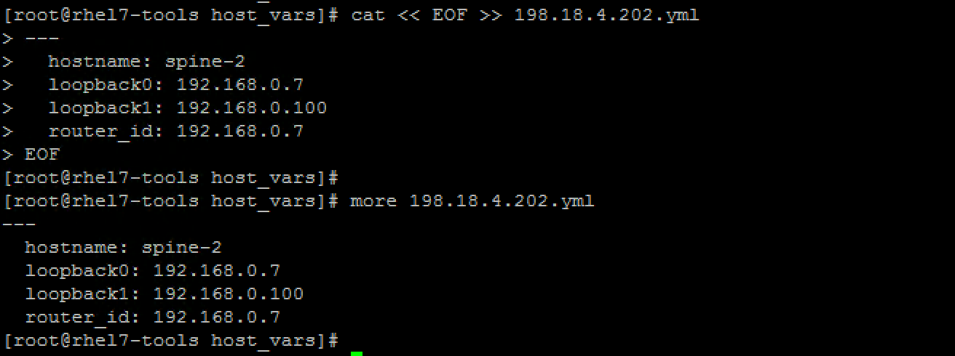

Slide 12
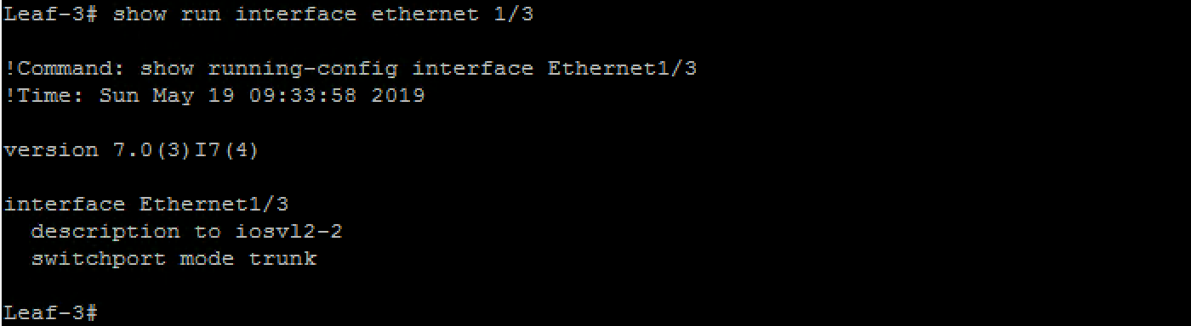
Page 23 … before running ansible playbook

Slide 13
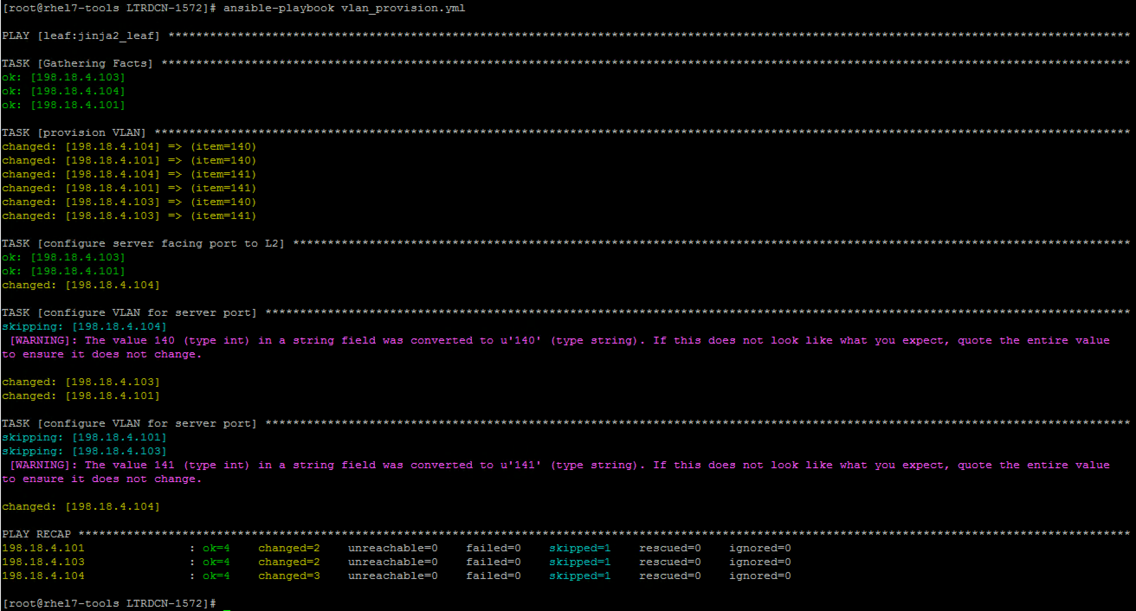

Slide 14
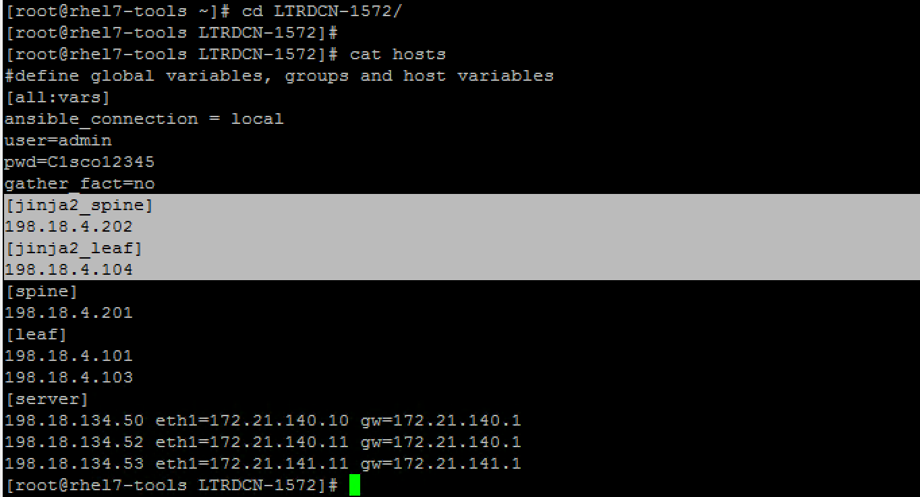
Page 26 add screenshot

Slide 15
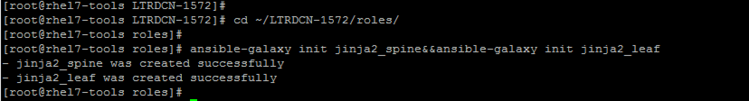
Page 27 new pic

Slide 16
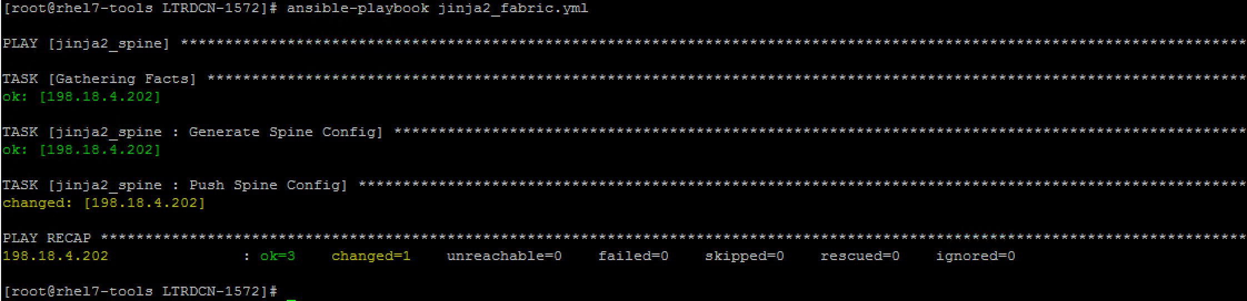
Task2 > step 7 … 3-7-1.png pic udpated

Slide 17
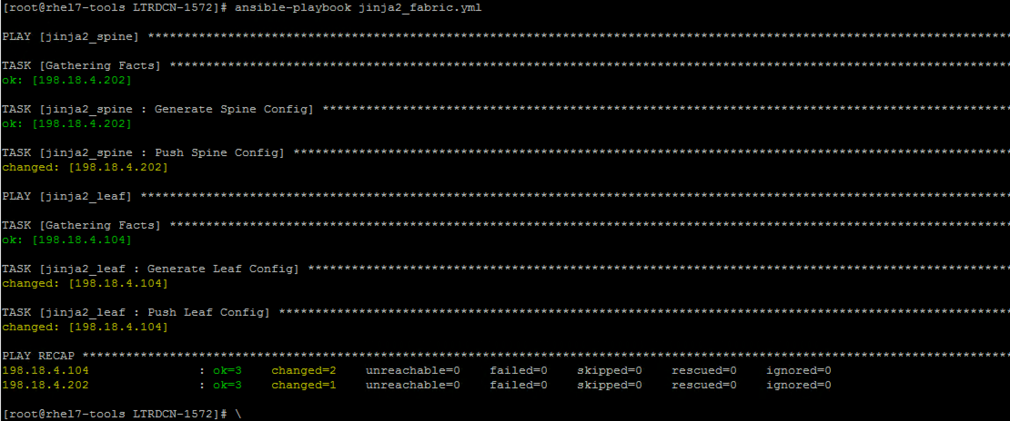
Task2: step 12 .. 3-12-1

Slide 18
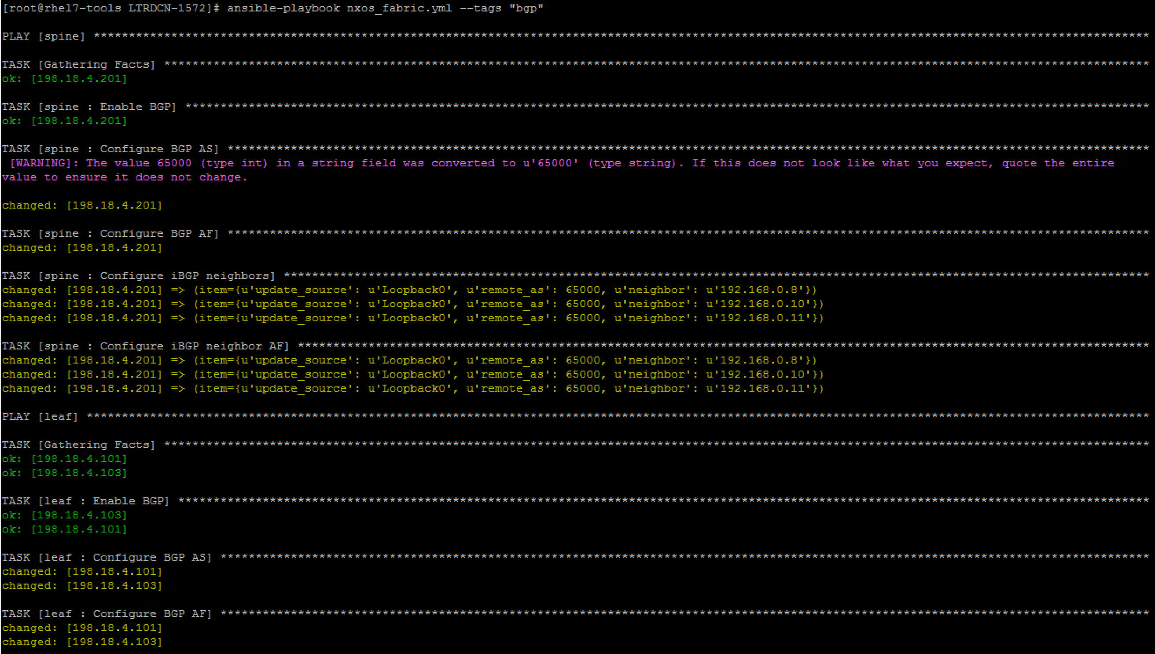
4-3-1.png

Slide 19
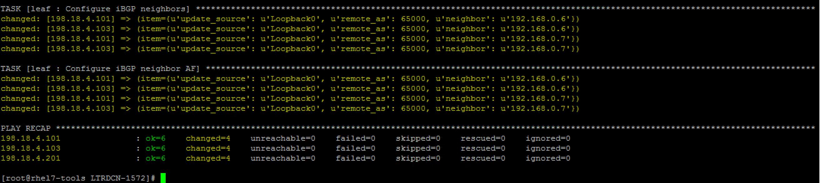
4-3-2.png

Slide 20
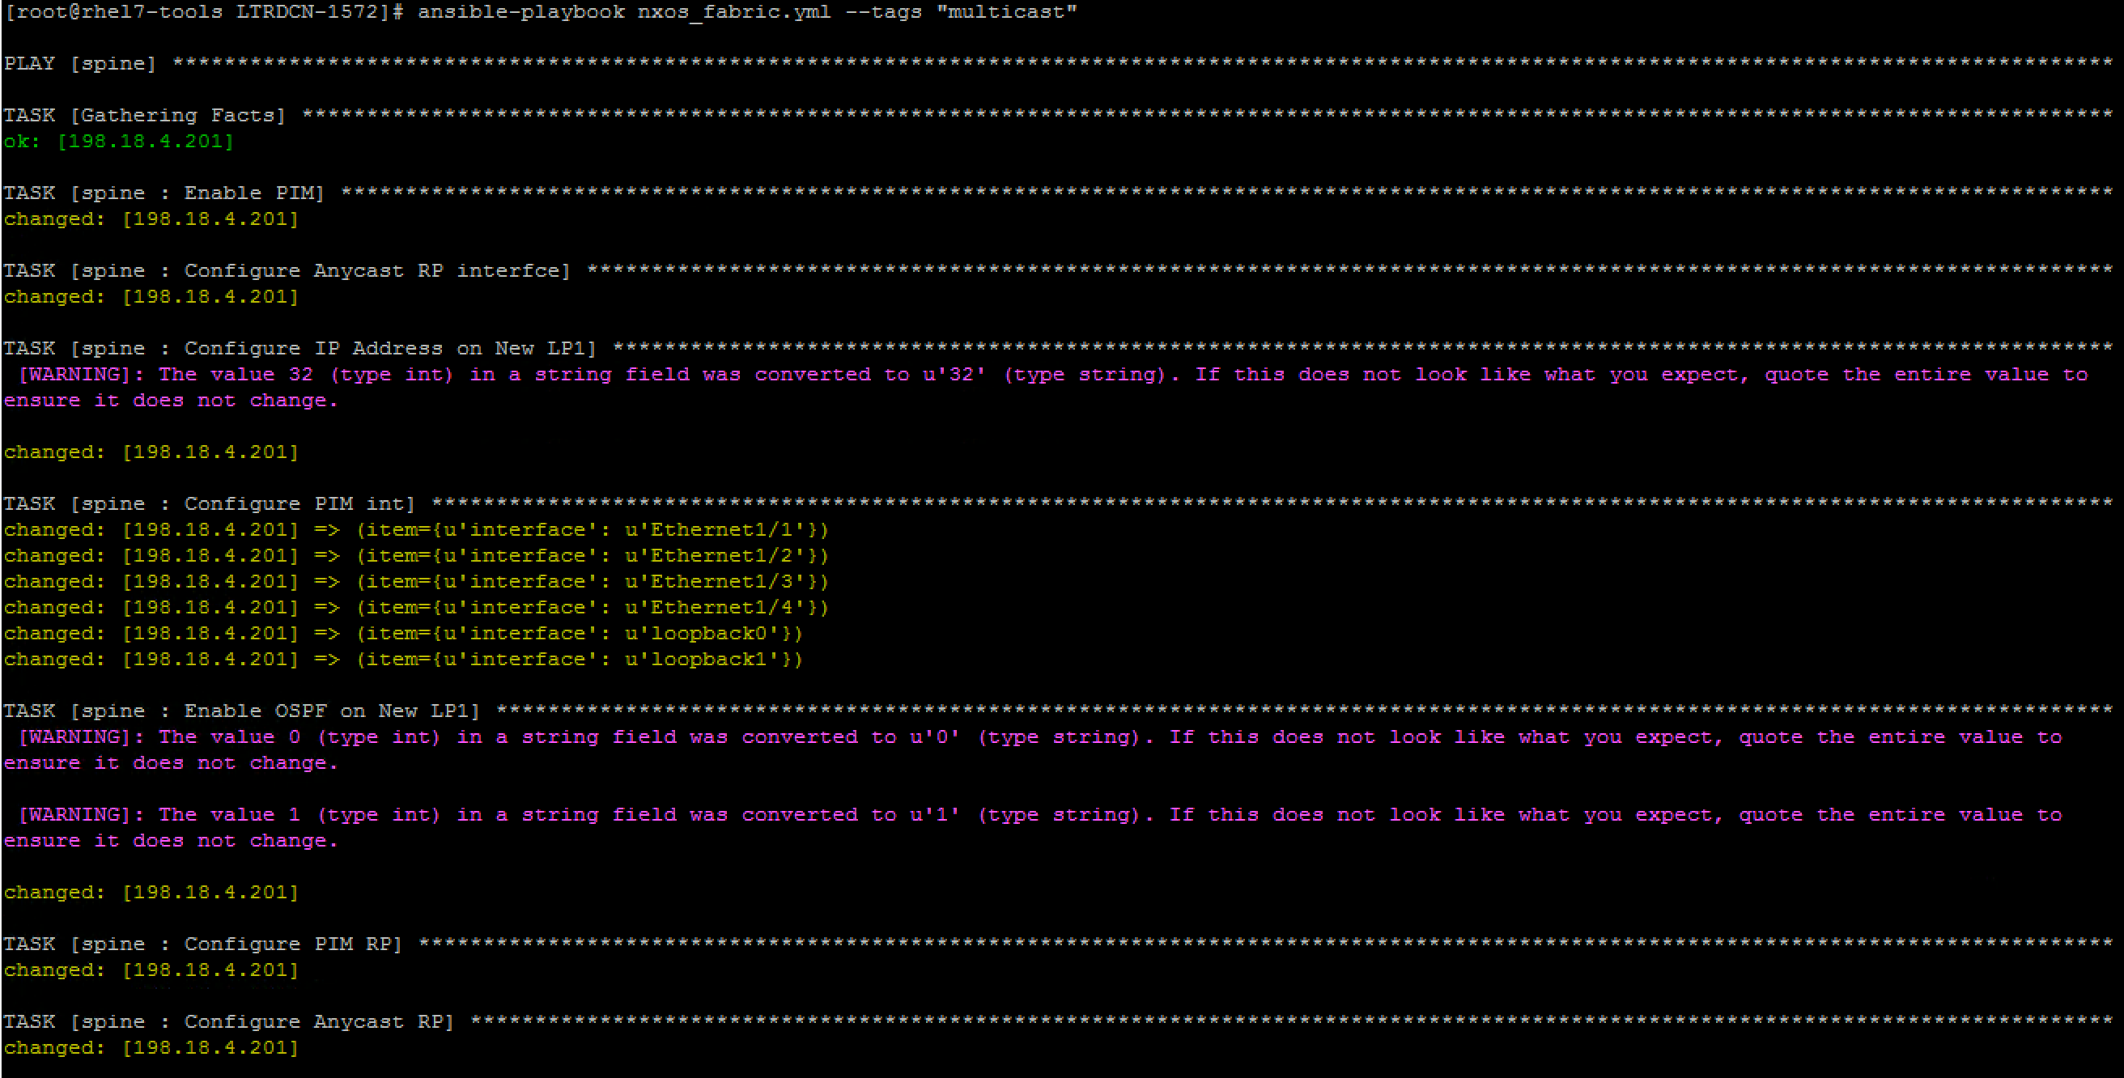
4-4-1.png

Slide 21
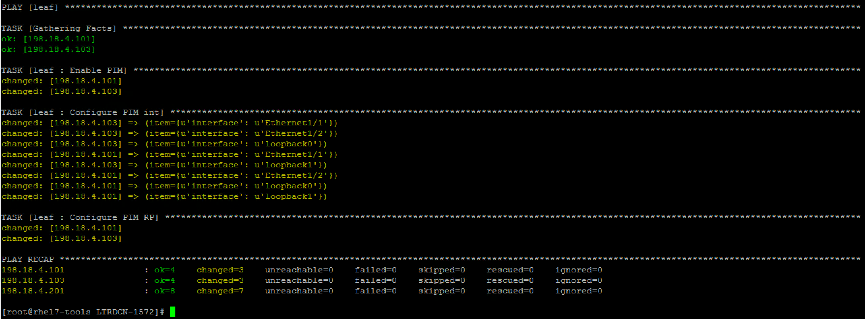
4-4-2.png

Slide 22
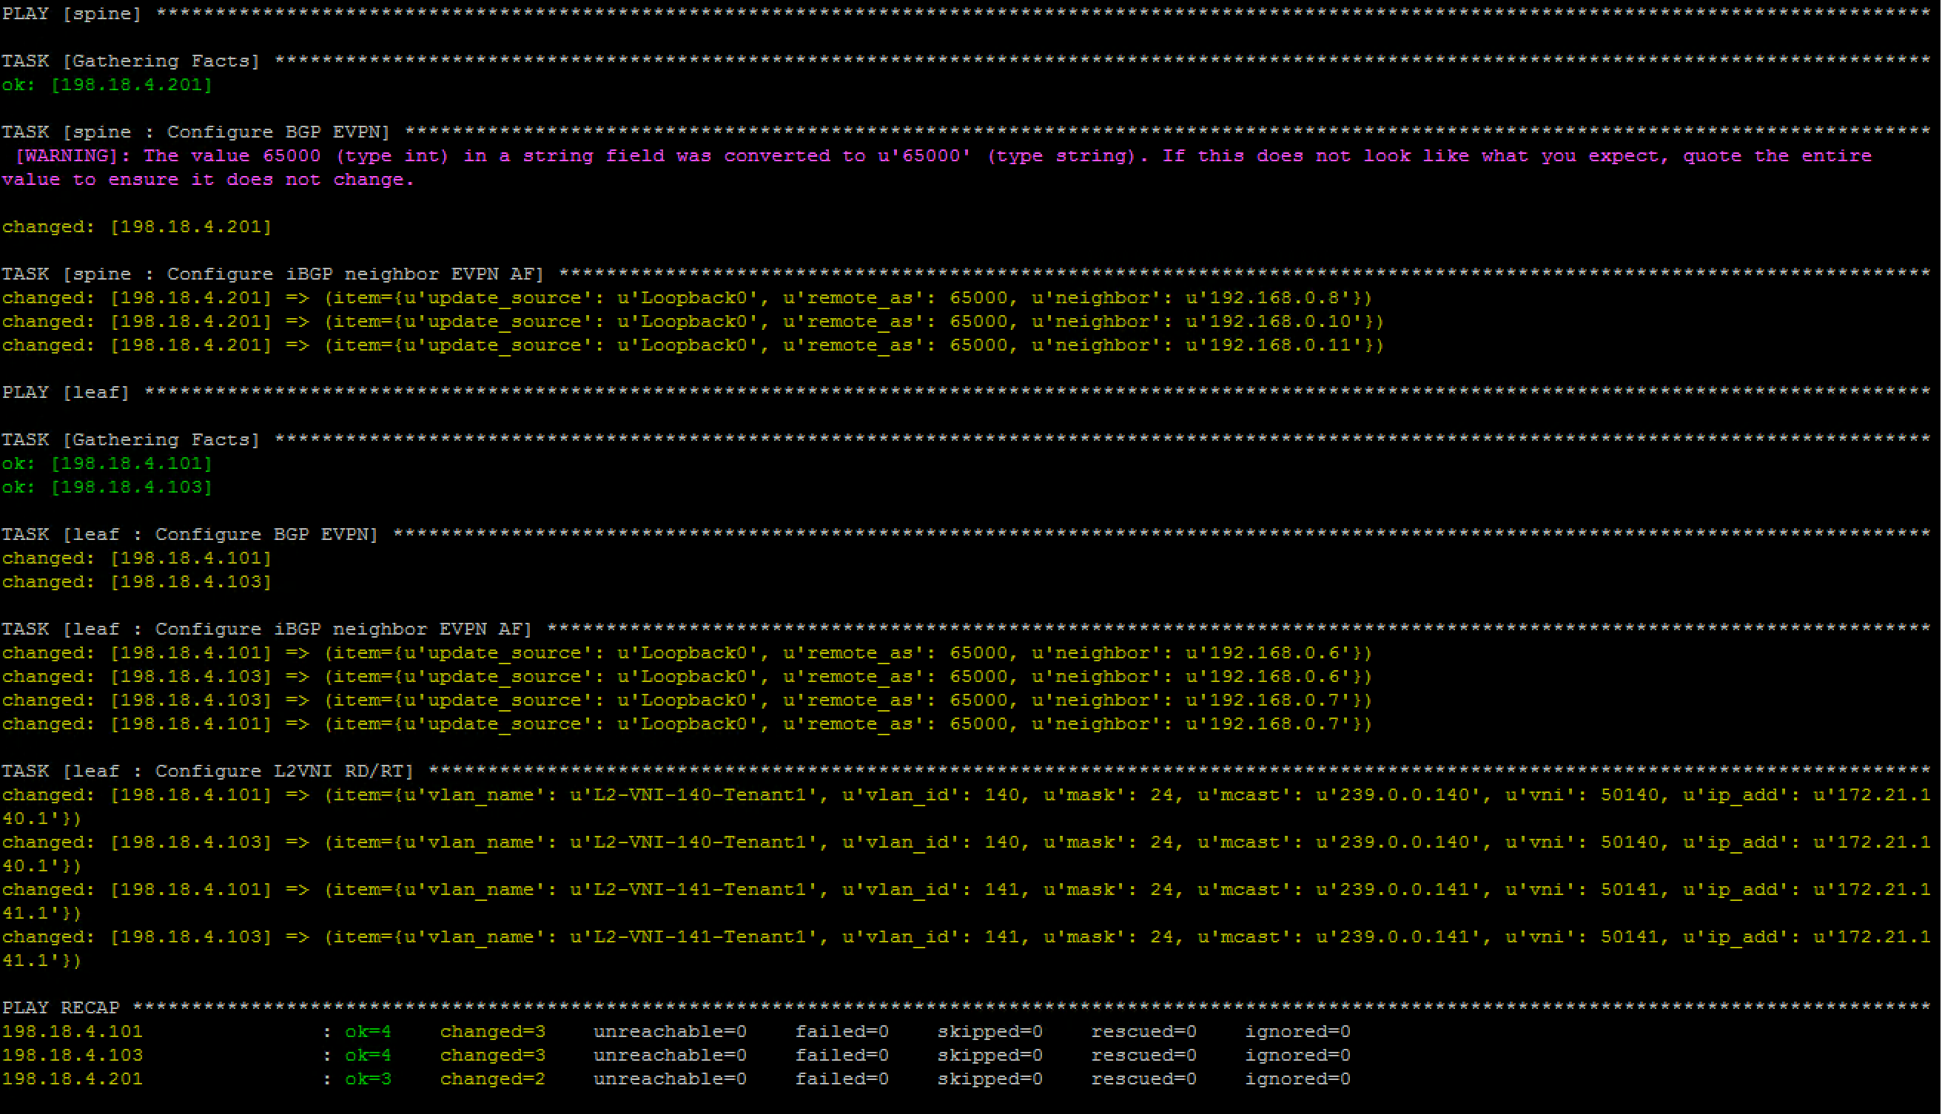
4-6-1

Slide 23
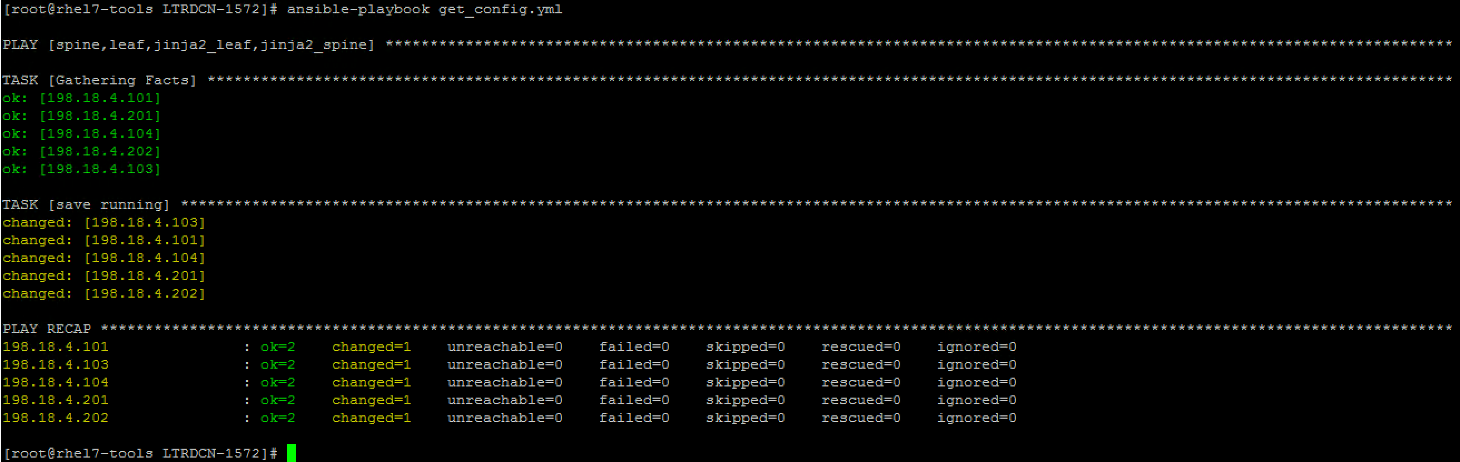
5-1-1

